Slide 1

PROJECT 3 - Learn to Use Spatial Database
CSE-6331: ADV TOPICS IN DATABASE SYSTEMS
Spring 2016
Prof: Dr. Elmasri
T.A. Neelabh Pant
Presented on: 5/2/2016
Presented by:
Anuj rakheja(1001119950)
Shyam gopal RAJANNA(1001248518)
Mudassir ahmed(1001108922)
Team - 9

Slide 2
Contents:
INTRODUCTION
TOOLS USED
DESIGN IMPLEMENTATION
RESULTS
CONCLUSION

Slide 3
INTRODUCTION
All our queries are based on the New York State Dataset.
Dataset consists of many shapefiles- nyc_census_blocks, nyc_homicides, nyc_neighborhoods, nyc_streets, nyc_subway_stations .
Our task was to perform spatial queries on this data and graphically represent the output using GIS.

Slide 4
Tools used
QGIS Browser 2.14.0 – To view the attributes of the database tables
QGIS Desktop 2.14.0 – To graphically represent the output of queries executed.
Spatiallite GUI for Windows 2.3.0 – To create and load the shape files in the database
Qspatialite (Spatialite plugin for QGIS) – To write, edit and execute the queries
Machine Configuration:
Intel i7 2nd Generation 2.0 Ghz
8 Gb RAM
Windows 7/10

Slide 5
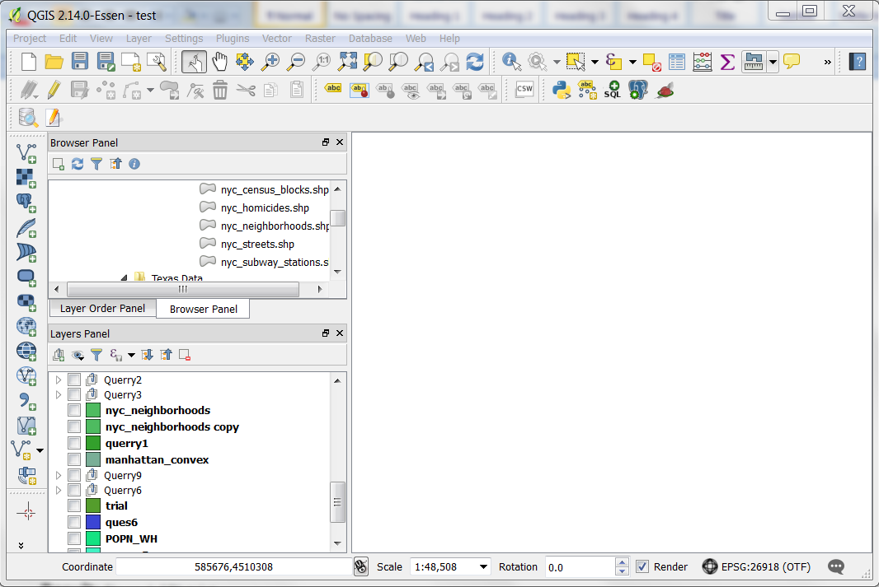
QGIS Desktop

Slide 6
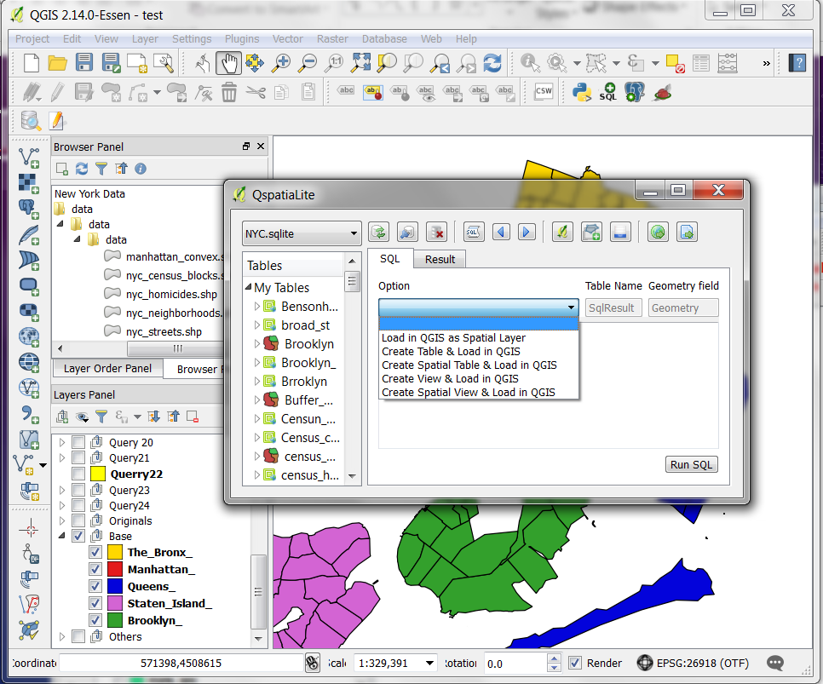
qSpatialite

Slide 7
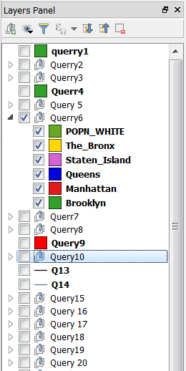
Design implementation
Created different spatial views, served as base spatial view.
Merged the spatial views required to show the final output.
Divided the spatial view in layers.
Low coupling among layers.
Re-used same spatial views for the output of different queries.

Slide 8
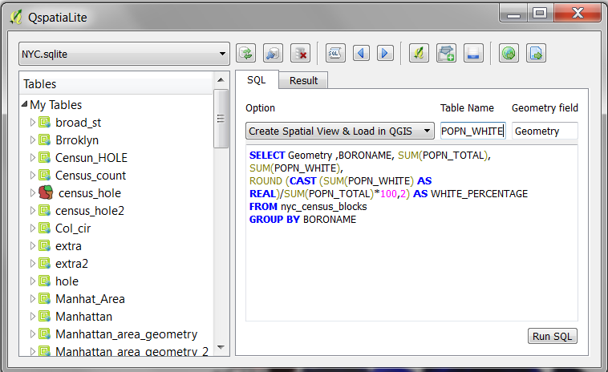
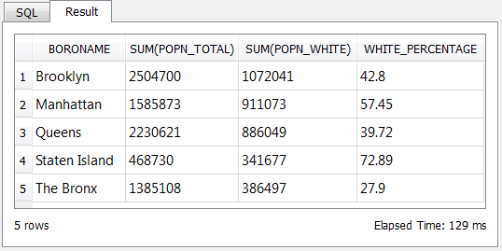
Example : Query 6
Find the percentage of white people for each borough

Slide 9

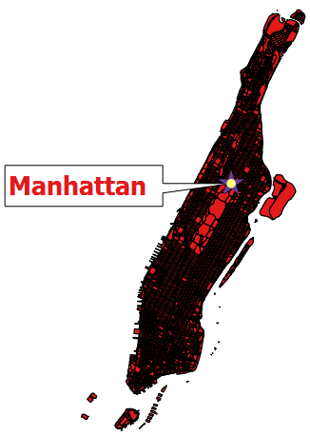
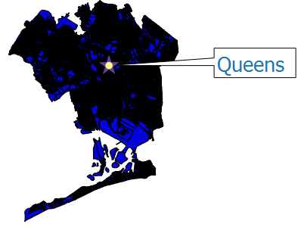
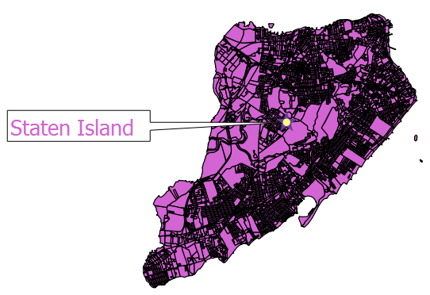
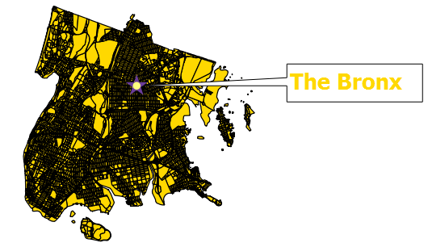
Layers
Layer 1
Layer 2
Layer 3
Layer 4
Layer 5

Slide 10
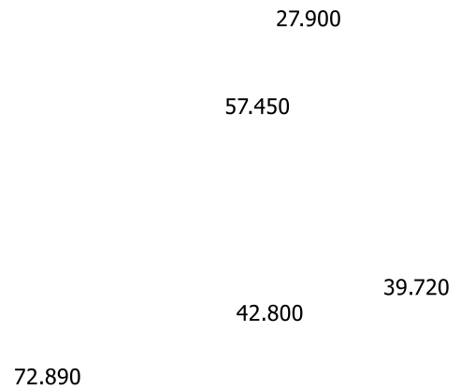
Final layer
Final Layer 6

Slide 11
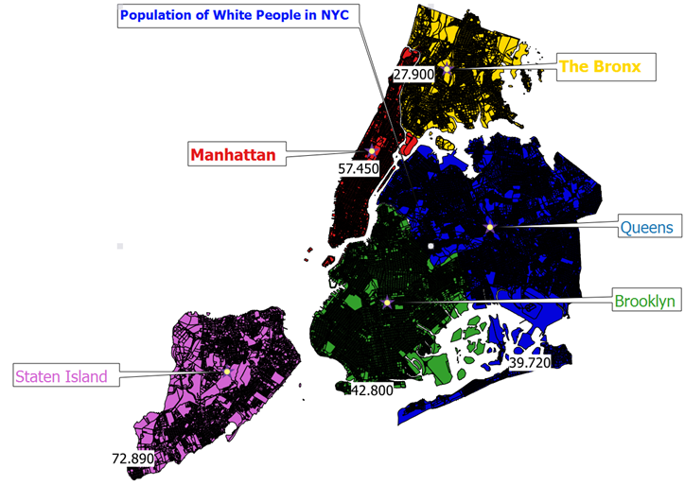
RESULT
Final View

Slide 12
Example : Query 19
Find the total number of people who live within 50 meters of ‘W Lake Dr’
Step 1: (Create Spatial Table):
SELECT Geometry, Name
FROM nyc_streets
Where Name = ’W Lake Dr’
Step 2: (Create Buffer):
Used QGIS Tool present in -> Menu>Vector>Geoprocessing Tools>Buffer(s)...
Select the Table and enter the distance to make buffer(here it is 50 m)
Step 3: (Check Within):
SELECT SUM(c.POPN_TOTAL)
FROM nyc_census_blocks AS c, Buffer_W_Lake_Drive as b
WHERE WITHIN (c.Geometry, b.Geometry);
Result: 0

Slide 13
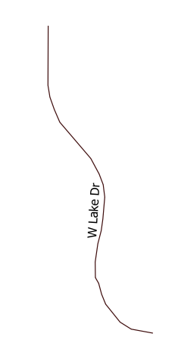

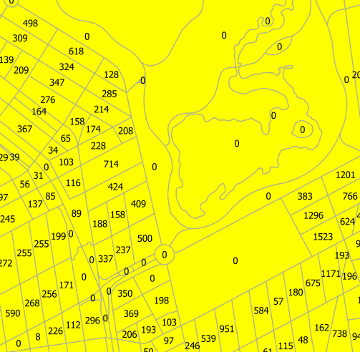
result
Layer 1
Layer 2
Layer 3

Slide 14
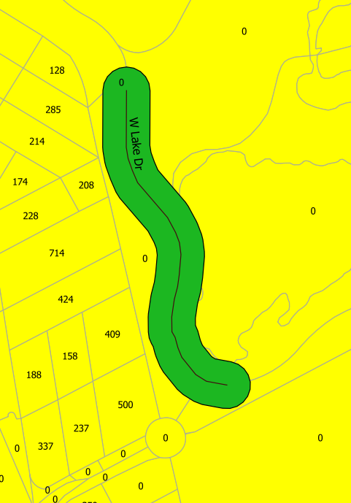
RESULT
Final Layer

Slide 15
Example : Query 23
What subway station is in ‘Bensonhurst’
Select s.LONG_NAME
FROM nyc_subway_stations AS s, nyc_neighborhoods AS n
WHERE N.NAME = 'Bensonhurst' and CONTAINS(n.Geometry, s.Geometry )
LONG_NAME
18th Ave (D,M) Brooklyn
20th Ave (D,M) Brooklyn
71st St (D,M) Brooklyn
79th St (D,M) Brooklyn
Bay Pky (D,M) Brooklyn
Bay Pky (N) Brooklyn

Slide 16
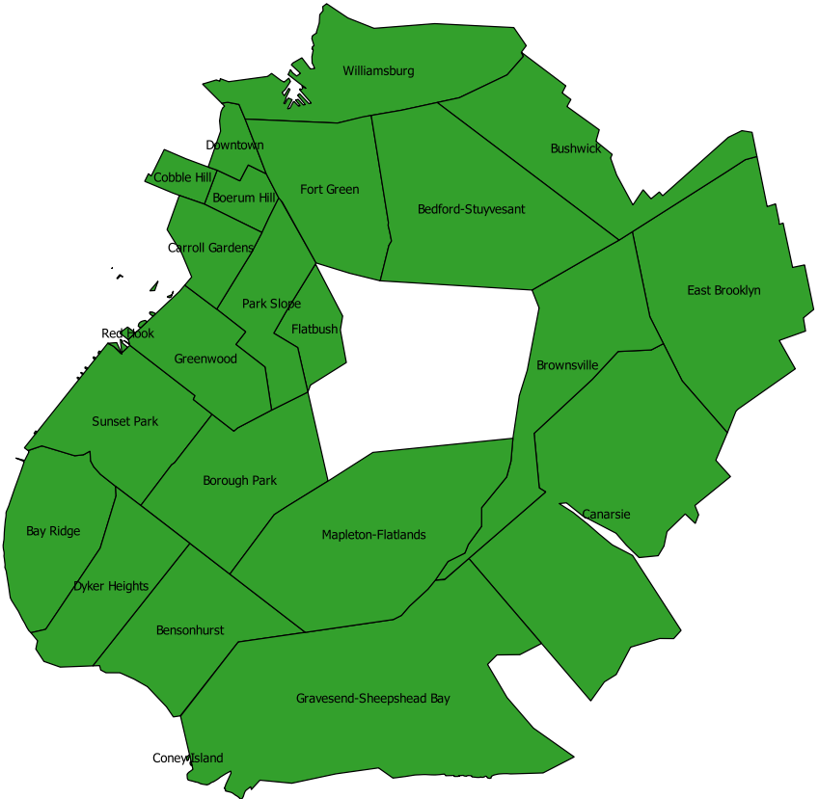
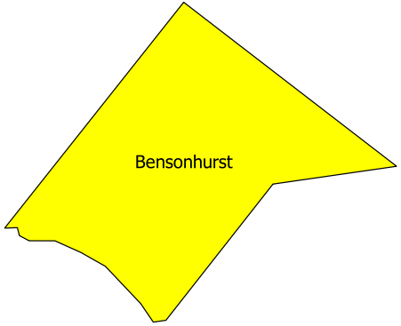
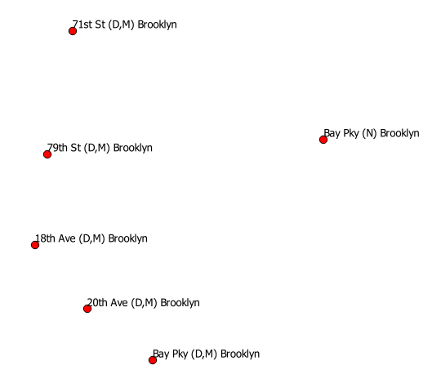
result
Layer 1
Layer 2
Layer 3
+
+

Slide 17
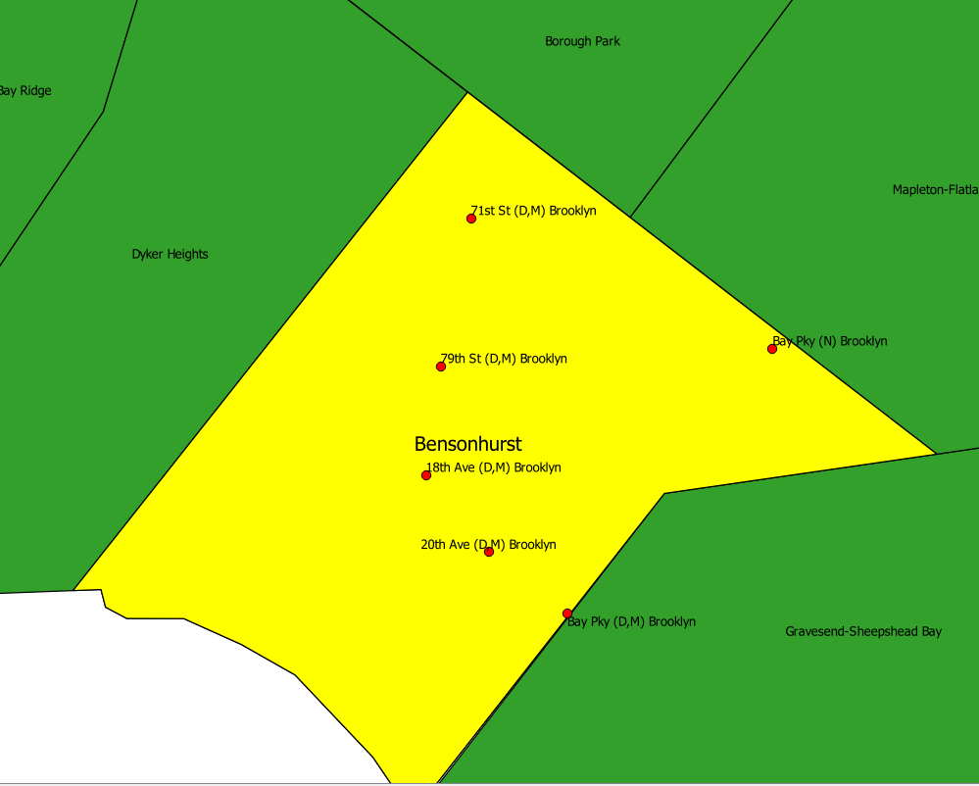
RESULT
Final Layer

Slide 18
conclusion
Learned various aspects of Spatial Database.
By forming different layers we achieved low coupling among the layers.
Reuse of layers formed for different tasks reduces space complexity.
Graphical presentation helps us to cross check our results thus enabling naïve users to understand output better.

Slide 19
Q / A
Thank you!!!

